Slide 1
Front End Engineering-I Project
Team Details:
AARADHYA MANAK(1754)
AARON VIJAY SINGH(1755)
AASTHA MALIK(1756)
Faculty Coordinator:
DR. RATTAN DEEP ANEJA
:
Chitkara University Institute of Engineering and Technology,
Chitkara University, Punjab

Slide 2
Table of Contents
Introduction
Problem Statement
Technical Details
Key Features
Project Highlights
Conclusion
References/Links used

Slide 3
Introduction
TITLE: Bigg Boss Voting Zone
PURPOSE AND DETAILS:
This project is a Html, CSS and Java Script based ‘Bigg Boss Voting Zone’ that allows the user to vote for their favourite contestant in an interactive and easy form.

Slide 4
Problem Statement
A voting platform is to be designed to show the increase/decrease in the votes of particular contestant using html, css and java script.
The platform should look quite dynamic to show the progress bars of each contestant.

Slide 5
Technical Details
HTML,CSS AND JAVA BASED VOTING ZONE:
Software used: Notepad++ and VS Code
Basic html knowledge regarding hyperlinking, creating classes, use of div tags,etc.
Basic CSS knowledge regarding animations,padding,types of CSS,text modifications, etc.
Basic Java Script knowledge regarding alert boxes, using onmouseevents, etc.

Slide 6
Key Features
Bigg Boss cover page and its ott logo to give a sense of security in minds of the users.
Navigaton buttons given to navigate between different webpages through hyperlinking.
The ‘User Details’ page is assigned to collect the user info of the voters and alert boxes are added so that the T&Cs are accepted by the user and to collect a valid phone no.
Animations are used on the Contestant page and a real-time timer is displayed at the bottom.
Thanks page to assure the voters that their vote has been registered.
Results page to display the result.

Slide 7
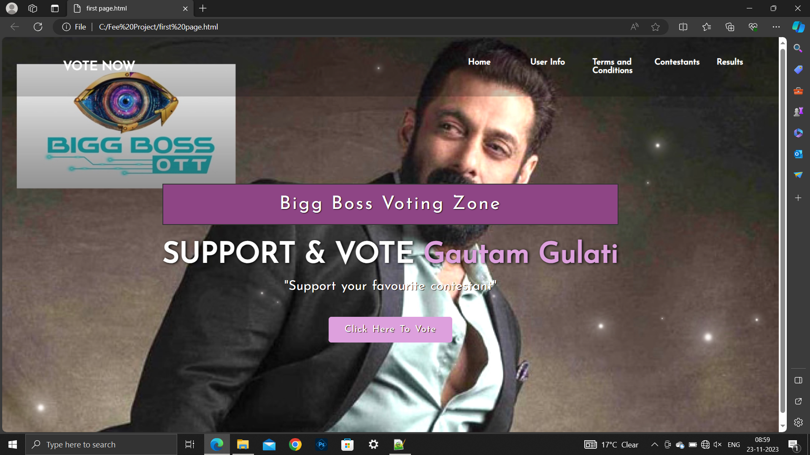
Project Highlights
FIRST PAGE

Slide 8
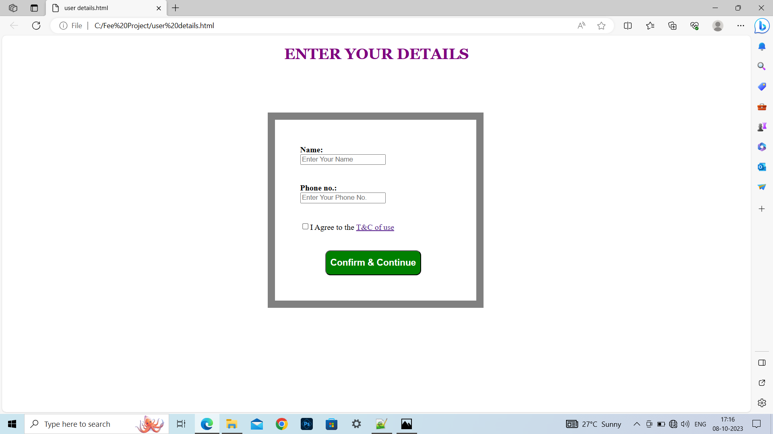
USER DETAILS PAGE

Slide 9
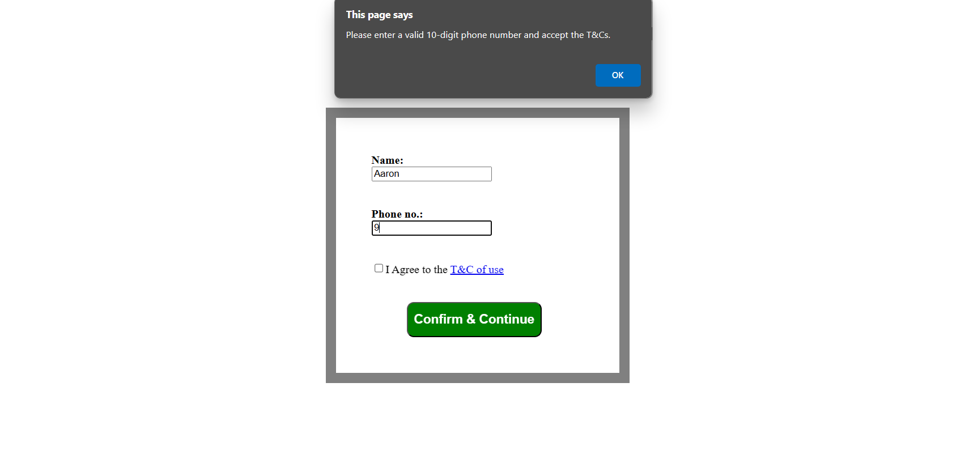
Alert Box for ticking the T&Cs and entering a valid phone no.

Slide 10
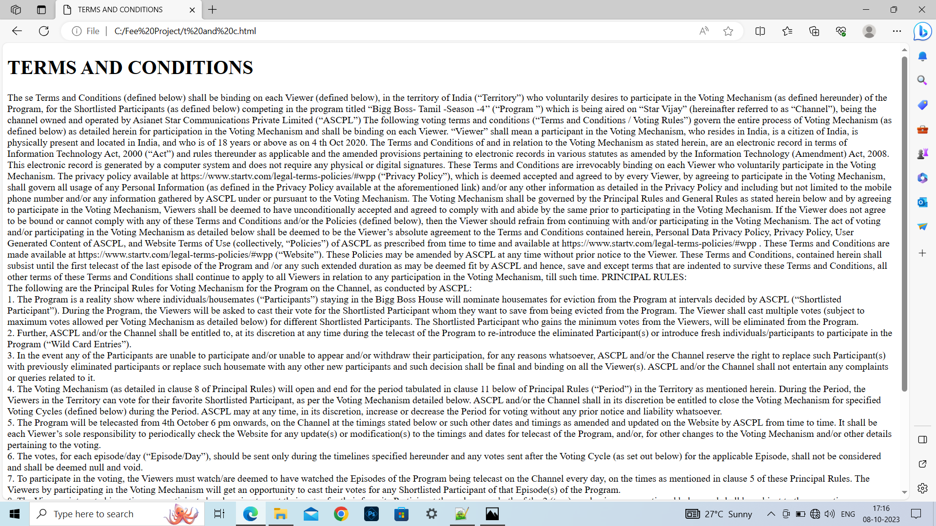
TERMS AND CONDITIONS PAGE

Slide 11
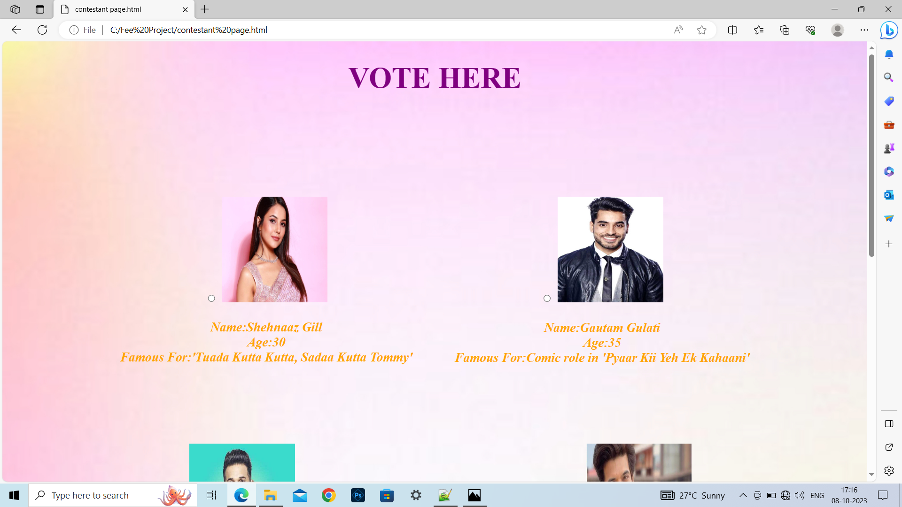
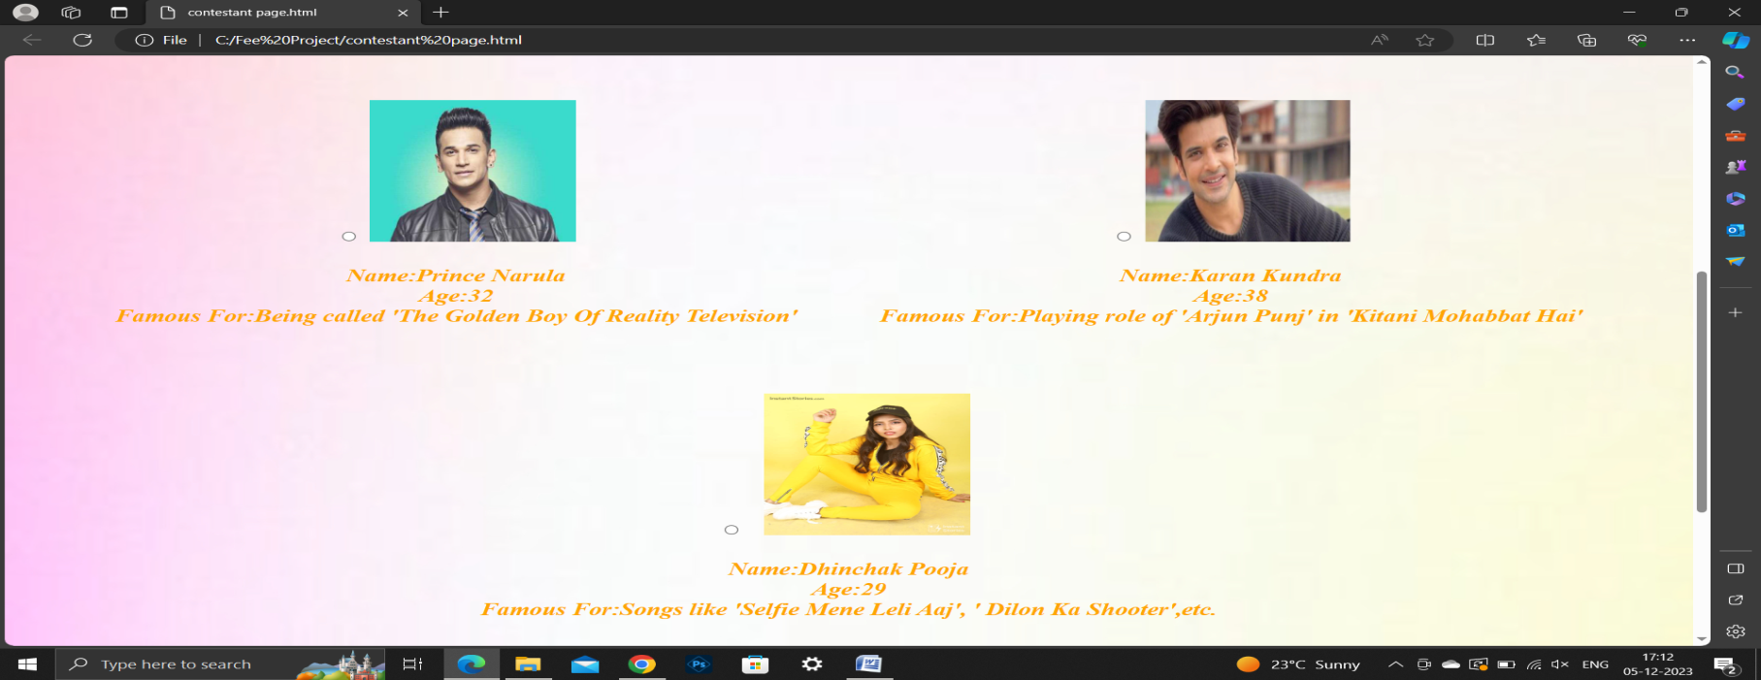
CONTESTANTS PAGE

Slide 12
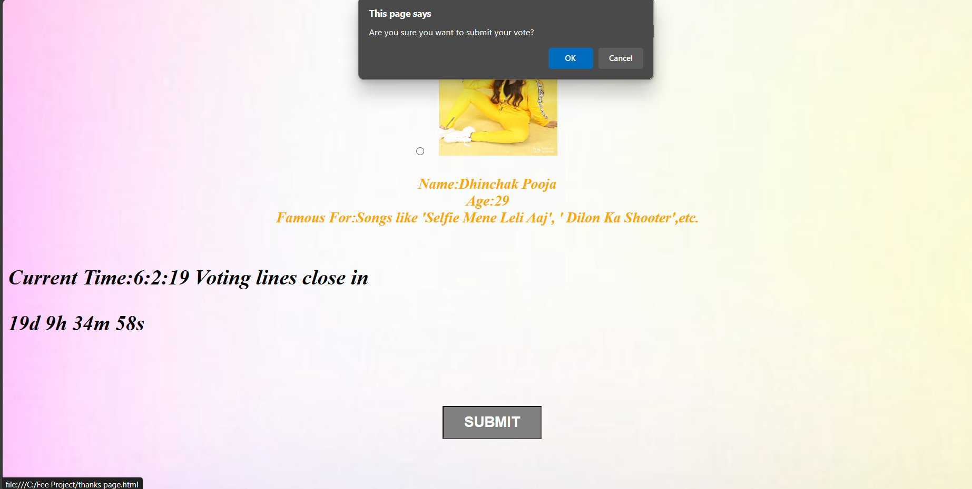
Confirmation Alert Box

Slide 13
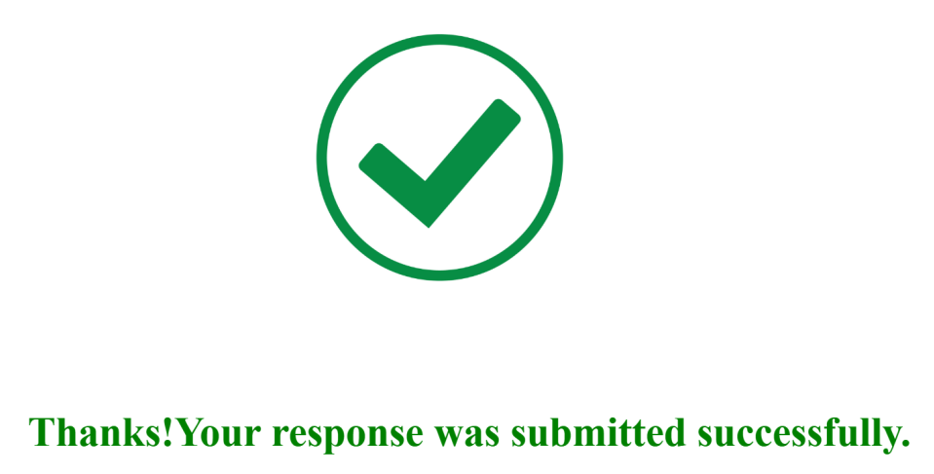
THANKS PAGE

Slide 14
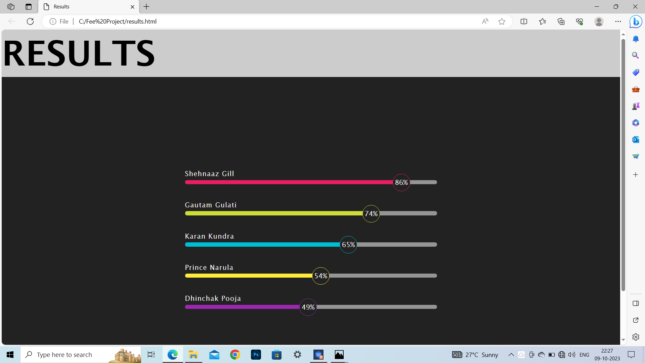
RESULTS PAGE

Slide 15
Conclusion
The project is made using different tags of html, different styles of CSS and different concepts of Java, their co-relation with each other,so our major takeaways are the uses of these tags, properties and become familiar and comfortable with them.

Slide 16
References/Links used
https://fonts.googleapis.com/css2?family=Josefin+Sans&display=swap
https://cdnjs.cloudflare.com/ajax/libs/animate.css/3.7.2/animate.min.css
https://www.w3schools.com/howto/howto_js_countdown.asp
Youtube
https://stackoverflow.com/questions/70444882/how-to-redirect-to-another-page-when-a-certain-condition-is-true-using-javascrip

Slide 17


